Slide 1
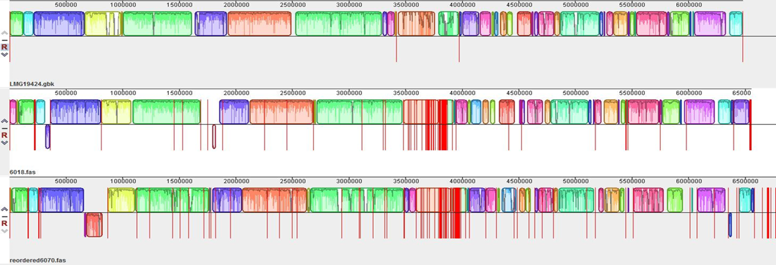
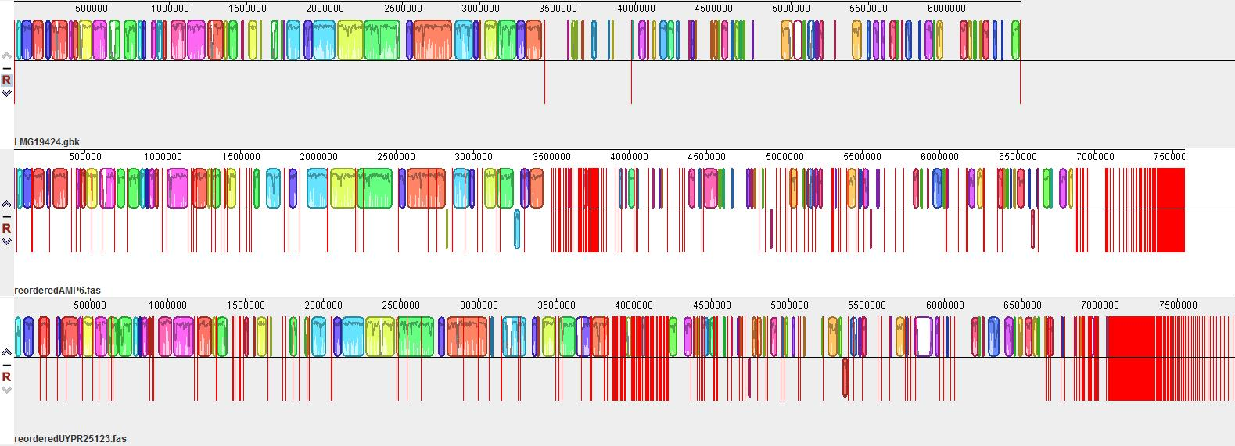
A
CHR1
pSym
CHR2 (chromid)
LMG9424
STM 6018
STM 6070
B
CHR1
pSym
CHR2
LMG9424
AMP6
UYPR2.512

